Slide 1
Sulfidation of Silver nanoparticles (ag np’s) on RO membrane
Dianne Carrillo
Host: Dr. Francois Perrault
Mentor: Ana Barrios
07/02/18

Slide 2
Reverse osmosis membranes (RO)
Further process used for treatments of industrial and municipal process waters.
“Reverse osmosis is the process of forcing a solvent from a region of high solute concentration through a semipermeable membrane to a region of low solute concentration by applying a pressure in excess of the osmotic pressure”
Membrane layer is extremely thin, it allows water to permeate or pass through preventing other compound from passing through. It
Removes molecules based on their size, shape, and charge, anything larger than water molecules will not pass through including chemical contaminants and microorganisms such as virus and bacteria.
Two streams of water are produced: pure clean water (permeate) and concentrate water (reject). Both streams of water flow from different outlet, concentrate water would go through another pressurized vessel to repeat the process to increase amount of pure permeate water.
Notes:
Warsinger, David M.; Tow, Emily W.; Nayar, Kishor G.; Maswadeh, Laith A.; Lienhard V, John H. (2016). "Energy efficiency of batch and semi-batch (CCRO) reverse osmosis desalination". Water Research. pp. 272–282. doi:10.1016/j.watres.2016.09.029.

Slide 3
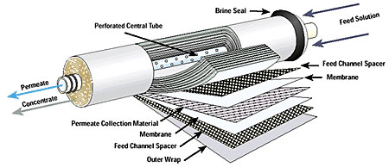
Feed water is forced through feed channel spacer, and into barrier layer of membrane water passes through membrane surface through permeate channel

Slide 4
Problem
Often become biologically fouled , the development of a microbial film on the feedwater surfaces of RO membrane results in severe effects.
Decline in the membrane water flux ( the rate at which water permeates on a reverse osmosis membrane)
Increase in transmembrane operating pressure
Increases energy consumption
The RO membrane polymer itself may also be directly or indirectly biodegraded by the organisms.
Loading Ag-NPs on RO membranes for biofouling mitigation
Silver nanoparticles (Ag-NPs), a known biocide, was used for their unique antibacterial, antiviral, and antifungal properties.
“ The formed Ag NPs imparted strong antibacterial activity to the membrane, leading to reduction of more than 75% in the number of live bacteria attached to the membrane for three model bacteria strains.
Testbed team identified fast silver release from silver-coated membranes that impair the long-term performance of antimicrobial coatings for biofouling control.
Silver leaches it very fast, slow down the leaching of silver NPs
Notes:
Ridgway H.F., Safarik J. (1991) Biofouling of Reverse Osmosis Membranes. In: Flemming HC., Geesey G.G. (eds) Biofouling and Biocorrosion in Industrial Water Systems. Springer, Berlin, Heidelberg
Ben-Sasson, Moshe et al. “In situ formation of silver nanoparticles on thin-film composite reverse osmosis membranes for biofouling mitigation.” Water research 62 (2014): 260-70.

Slide 5
Objectives
Studies have shown that Ag released from the membrane in the form of either Ag ions or AgNP will accelerate the antimicrobial activity of the membrane.
However, the silver release from the membrane will lower the silver loading on the membrane, which will eventually shorten the antimicrobial activity lifetime of the membrane. Therefore, the silver leaching amount is a crucial parameter that needs to be determined for every type of Ag composite membrane.
1) Reduce the solubility of silver nanoparticles by partial sulfidation of the particles.
2) Quantification of the antimicrobial activity of membranes functionalized with silver nanoparticles of different sulfidation levels.

Slide 6
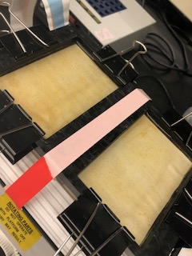
Sulfidation of silver nanoparticles
Materials used
BW30 RO membranes
3mM AgNO3
3mM NaBH4
Different concentrations of Na2S (10⁻¹ , 10⁻² , 10⁻³ , 10⁻⁴, and 10⁻⁵ )

Slide 7
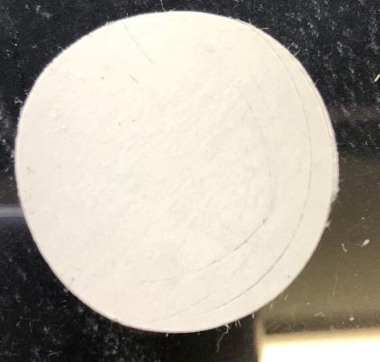
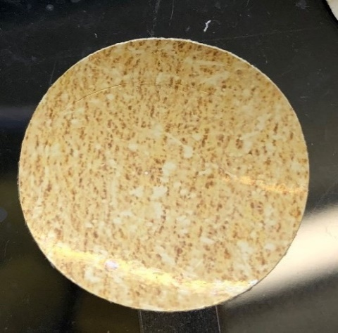
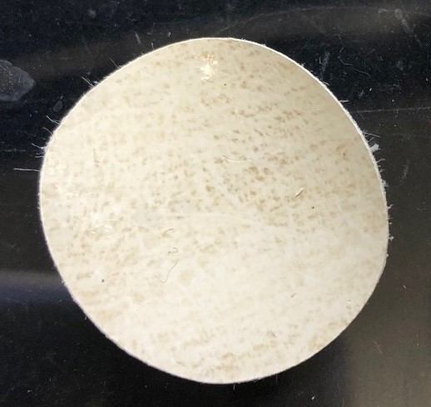
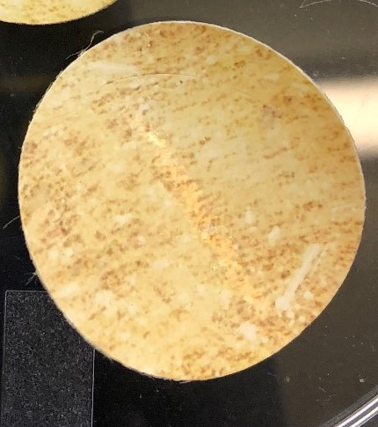
Methods
RO membranes are made by three layers polyamide layer, polysulfone, and polyester base
PA active layer
PS layer
Ag NP
Ag₂S
Pristine Membrane
Silver membrane
Ag2S (10⁻¹ )
Ag2S (10⁻⁵)

Slide 8
Coupons on membrane holder contact with E.coli & 0.9 % NaCl for 3 hours
Sonicated for 5 mins
Diluted (1:10 & 1:100)
Plated

Slide 9
Bacteria
Live/dead assay
E. coli: W 3110
Live – green
Dead- red
Epifluorescence microscopy: LEICA Microscope

Slide 10
Controlled RO Membrane

Slide 11
Silver RO Membrane

Slide 12
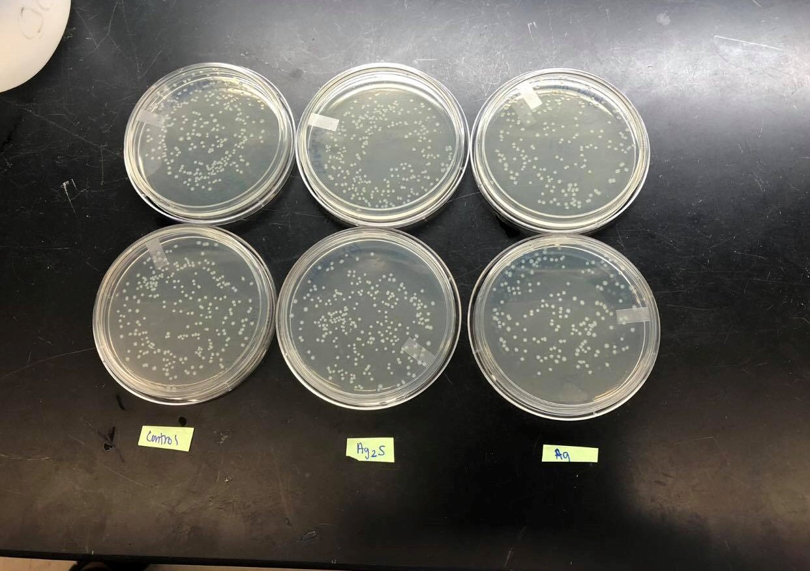
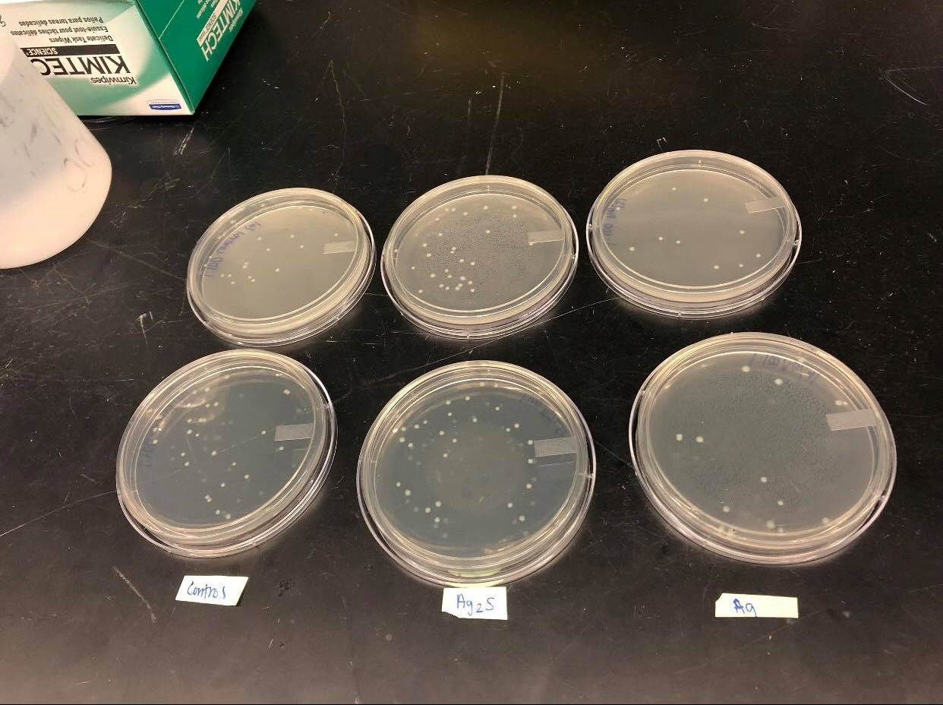
Plating
1:10
1:100

Slide 13
Plating
Conditions | 3h in 0.9% NaCl
 | 1x10^7 CFU mL
 | BW30 membranes, 1 in^2 coupons
Control vs Ag

Slide 14
Plating
Conditions | 3h in 0.9% NaCl
 | 1x10^7 CFU mL
 | BW30 membranes, 1 in^2 coupons
Control vs Ag vs Ag2S (10⁻¹ )

Slide 15
Plating
Conditions | 3h in 0.9% NaCl
 | 1x10^7 CFU mL
 | BW30 membranes, 1 in^2 coupons
Control vs Ag vs Ag2S (10⁻¹ and 10⁻⁵ )

Slide 16
Plating
Conditions
3h in 0.9% NaCl
1x10^7 CFU mL
BW30 membranes, 1 in^2 coupons

Slide 17
This week
Do 2 to 3 trials with:
Control
Ag
Ag2S (10⁻³ )
Ag2S (10⁻² )
Ag2S (10⁻⁴)
Compare results with RET, to see the rate of silver leaching

